Slide 1
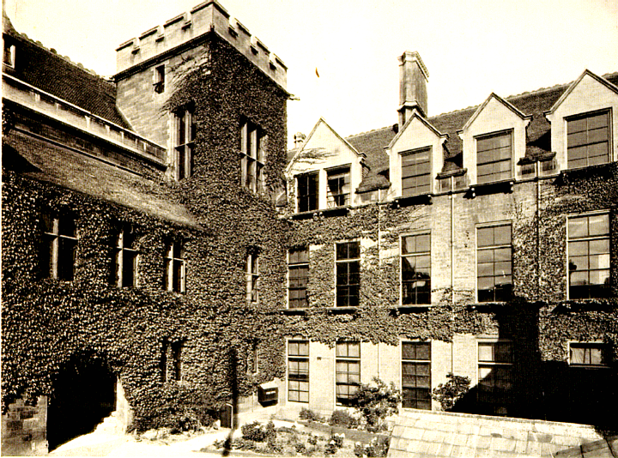
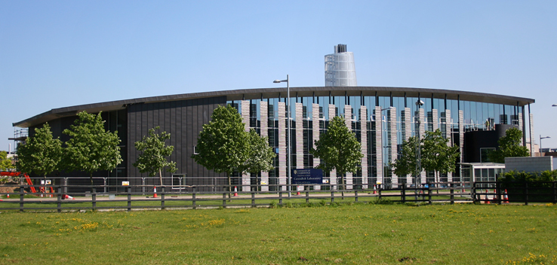
The Cavendish Laboratory Cambridge Physics experience: on line
DIY Rover Dr Steve Martin

Slide 2
Y7 practical activity
The task which follows is an adaptation of an activity which we do with our Y7, 8 visitors when they participate in the Cambridge Physics Experience
It can be done by individuals or teams, at home or in school, as a competition or just for fun, as your teachers and your school’s circumstances require.

Slide 3
The scenario
The CPE afternoon is themed round aspects of the ‘Mars Rover’ and groups look at different aspects of what goes into designing such a vehicle: some of the demonstrations are in a separate, accompanying presentation
Some of our visitors design and build powered model rovers from LEGO and then try then out in our mini Martian landscape of sand and boulders to see which design copes best with the terrain
Today we are suggesting experimentation with a miniature vehicle you can make from easily available domestic materials.

Slide 4
SAFETY FIRST!
Depending on exactly how you tackle this project, you may be doing some cutting of card or thin plastic; when you have finished, the ‘rover’ is driven by energy stored in an elastic band. Both of these can pose hazards if you are careless, so:
Have a go at this at school under the direction of a teacher, or if you are at home when a carer is around
Any cutting or making of holes in materials should be done only over a surface where damage does not matter; cut AWAY from yourself and NEVER hold an item in one hand while using a sharp implement on it with the other
Only wind up the rover a little at a time until you are sure of how it will perform: very tight rubber bands can snap and fly at you and send the driving rod spinning round uncontrollably. Both can be a danger for facial or eye injury

Slide 5
Making the ROVER
Here is what we used when we built ours
Of course you can try other items, depending what is available and the ideas you may have for making a really agile rover: the STOUT rubber band needs to be about the same length as the cylindrical object on the right
In a later slide there are some hints and tips, as we don’t want you to waste your time ……. but do try experimenting as applying scientific ideas is always really good

Slide 6
How to proceed 1
We poked a hole in each end of the curry pot, so that the rubber band can go right through (a big cotton reel or an item with a hole right through avoids this task.)
Then we threaded the band through both ends, anchoring one end with the small stick (matchstick is good). We secured this with some Sellotape, like this.

Slide 7
How to proceed 2
Here is the other end showing the reaction rod which drives the rover along.
Notice the yellow washer (made from the old margarine lid) . This is important : it is to make a gap between the reaction rod and the end surface to prevent too much rubbing and friction.
Wind up the reaction rod just a bit and put the rover on the floor: it should trundle along nicely. DON’T overwind as broken bands and flying rods can injure.

Slide 8
What next?
Once your rover is working then it is up to you and your teachers.
You might have a competition to see whose will climb the biggest obstacle or go the farthest (or whatever else you fancy!)
Such activity means that you can think about developments and improvements.
(The length of the rod might be important; we added the small rubber bands to ours to act as tyres ..... But it is up to your imagination)
Apart from that do have fun with this and we hope you may join us in Cambridge and work with our motorised rovers travelling over our simulated Martian landscape!

