Slide 1
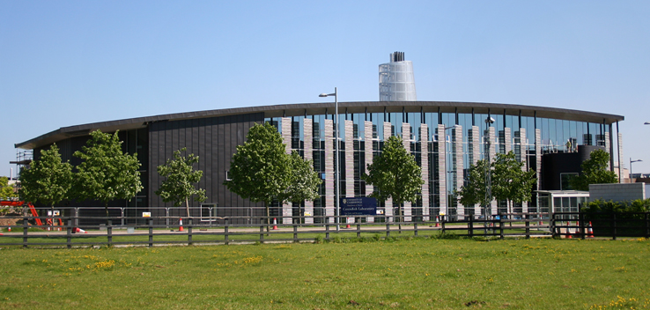
The Cavendish Laboratory Cambridge Physics experience: on line
Dr Steve Martin (based on a presentation by Katherine Drew, Fitzwilliam College)

Slide 2
Where might you be heading after school?
Work
Gap year
University

Slide 3
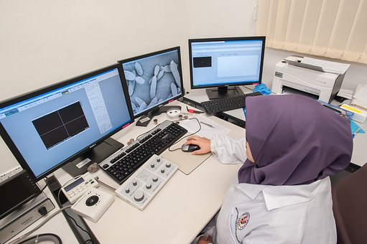
University
Deeper study
Research and taught
Transferable skills
Gain a degree
Move away from home

Slide 4
Benefits
Independence
Meet new people
Try new things
Study what you love
Better job prospects

Slide 5
What’s in it for you?
 | (%) Employment | (%) High Skill Employment | Average Salary (yearly)
Non-Graduates
Graduates
Post-Grads
70%
22%
£22.5k
86%
66%
£32k
89%
78%
£38k
Department for Education: Graduate Market Labour Statistics 2016 (Published April 2017)

Slide 6
Over a lifetime …….
2006
2007
2008
2009
2010
2011
2012
2013
2014
2015

Slide 7
Where matters too

Slide 8
CRUNCH QUESTION
HOW CAN I AFFORD UNIVERSITY?

Slide 9
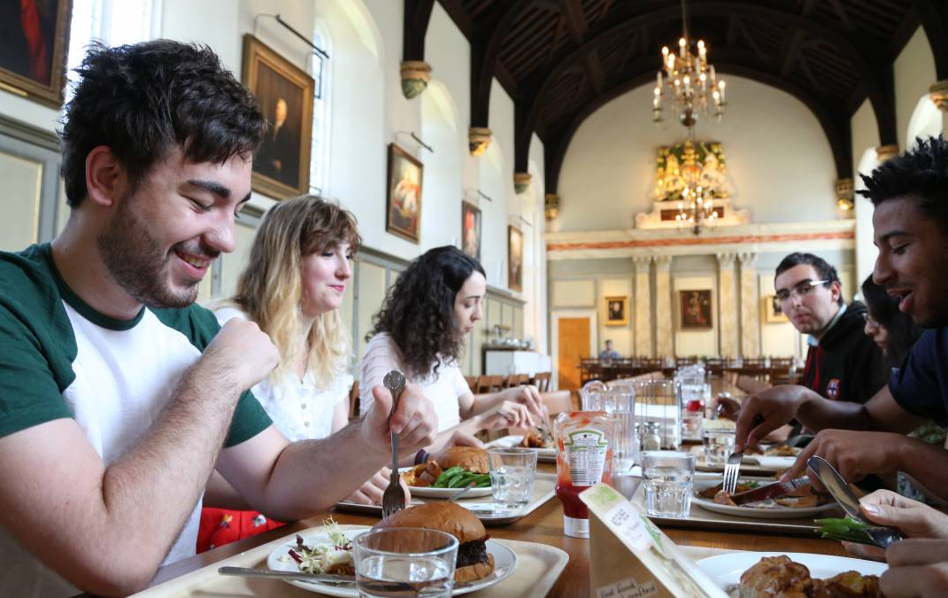
Finance PLEASE Note: the figures given are indicative and taken from a year or so ago: the general principles and relative costs are likely to be similar, going forward.
What do I pay?
Tuition fees (£9,250 per year)
Personal costs (£8,200 per year)
Rent
Food
Leisure

Slide 10
Finance
How do I pay?
Tuition
Government loan
Full cost
Living costs
Government loan
Household income dependent
College and University bursaries
NO UPFRONT COST

Slide 11
The obvious concern
REPAYMENT

Slide 12
Repayment
“Debt”
Doesn’t effect Credit Rating
Repaid only when
Graduated
Earning more than £25,000
“Graduate Tax”
Written off after 30 years

Slide 13
Repayment
How much do I pay back?
Annual Income | Monthly Salary | Monthly Repayment
Up to £25,000 | £2,083 | £0
£27,000 | £2,250 | £15
£30,000 | £2,500 | £37
£35,000 | £2,916 | £74
£40,000 | £3,333 | £112

Slide 14
SUMMARY
Reasons not to go to university
Good:
Won’t enjoy it
Want to do an apprenticeship
Don’t want to study any more
Bad:
You don’t think you can afford it
Worried you won’t fit in
No subject for you

Slide 15
QUESTIONS?
Have you booked your on-line Q&A session with the Cavendish outreach team?

